Slide 1
第5-1章 Motif Finding
Motif finding problem
EM algorithm
Markov chain Monte Carlo (Gibbs Sampler)
部分Slides来源于：
http://www.broadinstitute.org/annotation/winter_course_2006/index_files/Biological_Motif_Discovery.ppt
http://ai.stanford.edu/~serafim/cs262/Slides/Lecture17.ppt
http://people.csail.mit.edu/manoli/6096/Lecture4_GibbsSampling3.ppt

Slide 2
Transcriptional Regulation
The transcription of each gene is controlled by a regulatory region of DNA relatively near the transcription start site (TSS).
two types of fundamental components
short DNA regulatory elements
gene regulatory proteins that recognize and bind to them.

Slide 3
Regulation of Genes
Transcription Factor
(Protein)
RNA polymerase
(Protein)
DNA
Regulatory Element
Gene
source: M. Tompa, U. of Washington

Slide 4
Regulation of Genes
Transcription Factor
(Protein)
RNA polymerase
DNA
Regulatory Element
Gene
source: M. Tompa, U. of Washington

Slide 5
Regulation of Genes
mRNA
RNA polymerase
Transcription Factor
DNA
Regulatory Element
Gene
source: M. Tompa, U. of Washington

Slide 6
Transcriptional Binding Site
Wiki: DNA binding sites are a type of binding site found in DNA where other molecules may bind
Small (6-20bp)
Highly variable

Slide 7
Experimental Method (I)
DNase footprinting assay: The method uses an enzyme,deoxyribonuclease (DNase, for short), to cut the radioactively end-labeled DNA, followed by gel electrophoresis to detect the resulting cleavage pattern

Slide 8
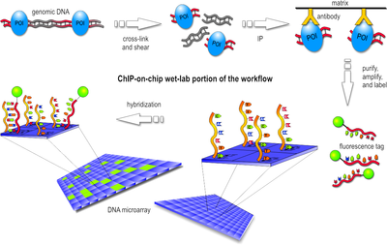
Experimental Method (II)
ChIP-chip or ChIP-Seq: is a technique that combines chromatin immunoprecipitation ("ChIP") with microarray (or sequencing) technology
http://en.wikipedia.org/wiki/ChIP-chip

Slide 9
Motif Finding
Find promoter motifs associated with co-regulated or functionally related genes
Genes regulated
by same
transcription
factor

Slide 10
Input Sequences
ChIP-chip experiment.
Promoter sequences from a cluster of microarray data (or functional related genes)
Conserved noncoding sequences among different species.

Slide 11
Essential Tasks
Modeling motifs
Visualization motifs
Finding motif

Slide 12
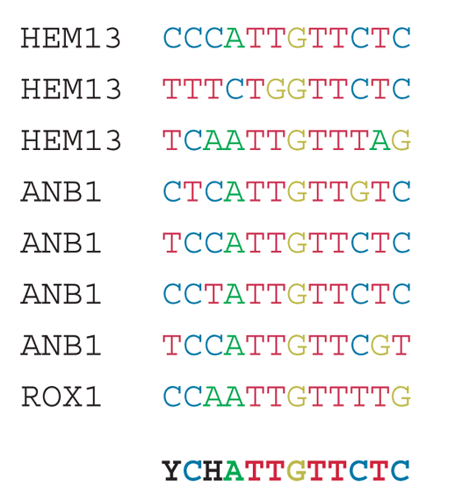
Consensus
Nature Biotechnology 24, 423 - 425 (2006)

Slide 13
Probabilistic Model
Positional weighted matrix (PWM)
L x 4 matrix, where L is the length of the motif
Each position is a probability distribution (p(A), p(C), p(G), P(T))
Independence between different position

Slide 14

PWM
 | 1 | 2 | 3 | 4 | 5 | 6
A | 0 | 0 | 0.25 | 0.875 | 0 | 0
C | 0.5 | 0.75 | 0.5 | 0.125 | 0 | 0.125
G | 0 | 0 | 0 | 0 | 0 | 0.875
T | 0.5 | 0.25 | 0.25 | 0 | 1.0 | 0

Slide 15
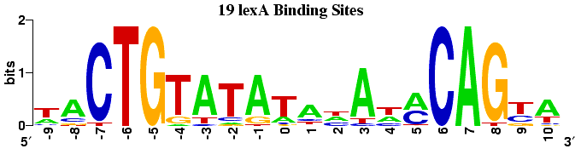
Motif Information
The height of a stack is often called the motif information at that position measured in bits
Information
Why is this a measure of information?

Slide 16
随机事件的信息量 (I)
如果说“明天的太阳会从东边升起”，你会觉得这是一句废话，因为没有得到任何信息。
反过来，如果说“明天会发生日食”，你会觉得很吃惊，感觉到得到了很多信息。
因此，信息量的多少与随机事件发生的概率有关，是概率的函数 f(p).

Slide 17
随机事件的信息量 (II)
相互独立的两个随机事件同时发生引起的信息量是分别引起的信息量之和。
什么函数具有上述性质？可以证明，唯有对数函数具有上述性质。

Slide 18
随机分布的信息量
定义为每个可能的随机事件的平均信息量。
若离散分布S有n个取值，p_{i}是相应取值的概率。则分布S的熵定义为

Slide 19
Entropy
Entropy measures average uncertainty
Entropy measures randomness
If log is base 2, then the units are called bits

Slide 20
Entropy versus Randomness
Entropy is maximum at maximum randomness
1
Example: Coin Toss
0.9
0.8
P(heads)=0.1 Not very random
H(X)=0.47 bits
0.7
0.6
Entropy
0.5
0.4
P(heads)=0.5 Completely random
H(X)=1 bits
0.3
0.2
0.1
0
0
0.1
0.2
0.3
0.4
0.5
0.6
0.7
0.8
0.9
1
P(heads)

Slide 21
Entropy Examples
1
0.9
0.8
0.7
P(x)
0.6
0.5
0.4
0.3
0.2
0.1
0
1
2
3
4
A
T
G
C
1
0.9
0.8
0.7
P(x)
0.6
0.5
0.4
0.3
0.2
0.1
0
A
T
G
C
1
2
3
4

Slide 22
Motif Information
Motif Position Information =
H_{background}(X)
H_{motif_i}(X)
Prior uncertainty about
nucleotide
Uncertainty after learning it is
position i in a motif
1
1
0.9
0.9
0.8
0.8
0.7
0.7
P(x)
P(x)
0.6
0.6
0.5
0.5
0.4
0.4
0.3
0.3
0.2
0.2
0.1
0.1
0
A
T
G
C
0
A
T
G
C
H(X)=2 bits
H(X)=0.63 bits
Uncertainty at this position has been reduced by 1.37 bits

Slide 23
Motif Logo
Conserved Residue
Reduction of uncertainty
of 2 bits
Little Conservation
Minimal reduction of
uncertainty

Slide 24
Background DNA Frequency
The definition of information assumes a uniform background DNA nucleotide frequency
What if the background frequency is not uniform?
(e.g. Plasmodium)
H_{background}(X)
H_{motif_i}(X)
1
1
0.9
0.9
0.8
0.8
0.7
0.7
P(x)
P(x)
0.6
0.6
0.5
0.5
0.4
0.4
0.3
0.3
0.2
0.2
0.1
0.1
0
A
T
G
C
0
A
T
G
C
H(X)=1.7 bits
H(X)=1.9 bits
Motif Position Information =
Some motifs could have negative information!

Slide 25
A Different Measure
Relative entropy or Kullback-Leibler distance (divergence)
Property

Slide 26

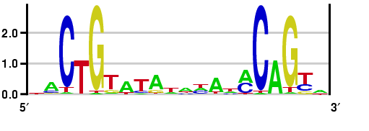
Comparing Both Methods
Information assuming
uniform background
DNA
KL Distance assuming
20% GC content
(e.g. Plasmodium)

Slide 27
Finding New Motifs
Learning Motif Models

Slide 28
Motif Finding Problem
Given a set of sequences, find the motif shared by all or most sequences, while its starting position in each sequence is unknown
Assumption:
Each motif appears exactly once in one sequence
The motif has fixed length

Slide 29
Generative Model
Suppose the sequences are aligned, the aligned regions are generated from a motif model
Motif model is a PWM. A PWM is a position-specific multinomial distribution.
For each position i, a multinomial distribution on (A,C,G,T): q_{iA},q_{iC},q_{iG},q_{iT}
The unaligned regions are generated from a background model: p_{A},p_{C},p_{G},p_{T}

Slide 30
A Promoter Model
Length K
Motif
Background DNA
M₁
M_{K}
M₁
A
C
G
T
.1
.2
.1
.4
.1
.3
.2
.2
.2
.2
.5
.4
.4
.5
.4
.2
.2
.2
.3
.1
.2
.2
.2
.1
P_{k}(S|M)
P(S|B)
The same motif model in all promoters

Slide 31
Probability of a Sequence
Given a sequence(s), motif model and motif location
1
60
65
100
A T A T G C
M₁
M_{K}
M₁
S_{i} = nucleotide at position i in
the sequence
A
C
G
T
.1
.2
.1
.4
.1
.3
.2
.2
.2
.2
.5
.4
.4
.5
.4
.2
.2
.2
.3
.1
.2
.2
.2
.1

Slide 32
Parameterizing the Motif Model
Given multiple sequences and motif locations but no motif model
M₁
M₁
M₆
AATGCG
ATATGG
ATATCG
GATGCA
A
C
G
T
3/4
1/2
1/2
1/4
Count Frequencies
Add pseudocounts
1/2
1/4
1/2
1/2
3/4
1/2
1/2
1/2

Slide 33
Finding Known Motifs
Given multiple sequences and motif model but no motif locations
x
P(Seq_{window}|Motif)
x
window
x
x
Calculate P(Seq_{window}|Motif) for every starting location
Choose best starting location in each sequence

Slide 34
The EM Approach
EM is a family of algorithms for learning probabilistic models in problems that involve hidden state
in our problem, the hidden state is where the motif starts in each training sequence

Slide 35
The MEME Algorithm
Bailey & Elkan, 1993
uses EM algorithm to find multiple motifs in a set of sequences
first EM approach to motif discovery: Lawrence & Reilly 1990

Slide 36
EM Algorithm for Motif Discovery
Start with random motif model
E Step: estimate probability of motif positions for each sequence
M Step: use estimate to update motif model
Iterate (to convergence)
At each iteration, P(Sequences|Model) guaranteed to increase

Slide 37
Demo: Initialization
Given a random motif model
A
C
G
T
0.1
0.2
0.1
0.4
0.1
0.3
0.2
0.2
0.2
0.2
0.5
0.4
0.4
0.5
0.4
0.2
0.2
0.2
0.3
0.1
0.2
0.2
0.2
0.1

Slide 38
Demo: E-Step
E Step: estimate probability of motif positions for each sequence

Slide 39
Demo: M-Step
M Step: use estimate to update motif model
A
C
G
T
0.1
0.1
0.1
0.1
0.1
0.3
0.2
0.3
0.2
0.2
0.5
0.1
0.4
0.5
0.4
0.5
0.2
0.1
0.3
0.1
0.2
0.2
0.2
0.1

Slide 40
Basic EM Approach
we’ll need to calculate the probability of a training sequence given a hypothesized starting position:
before motif
motif
after motif
is the ith sequence
is 1 if motif starts at position j in sequence i
is the character at position k in sequence i

Slide 41
Example
G C T G T A G
0 1 2 3
A 0.25 0.1 0.5 0.2
C 0.25 0.4 0.2 0.1
G 0.25 0.3 0.1 0.6
T 0.25 0.2 0.2 0.1

Slide 42
The E-step: Estimating Z
To estimate the starting positions in Z at step t
This comes from Bayes’ rule applied to

Slide 43
The E-step: Estimating Z
Assume that it is equally likely that the motif will start in any position

Slide 44
Example: Estimating Z
G C T G T A G
0 1 2 3
A 0.25 0.1 0.5 0.2
C 0.25 0.4 0.2 0.1
G 0.25 0.3 0.1 0.6
T 0.25 0.2 0.2 0.1
...
Then normalize so that

Slide 45
The M-step: Estimating p
recall represents the probability of character c in position k ; values for position 0 represent the background
pseudo-counts
total # of c’s
in data set

Slide 46
Example: Estimating p
A C A G C A
A G G C A G
T C A G T C

Slide 47
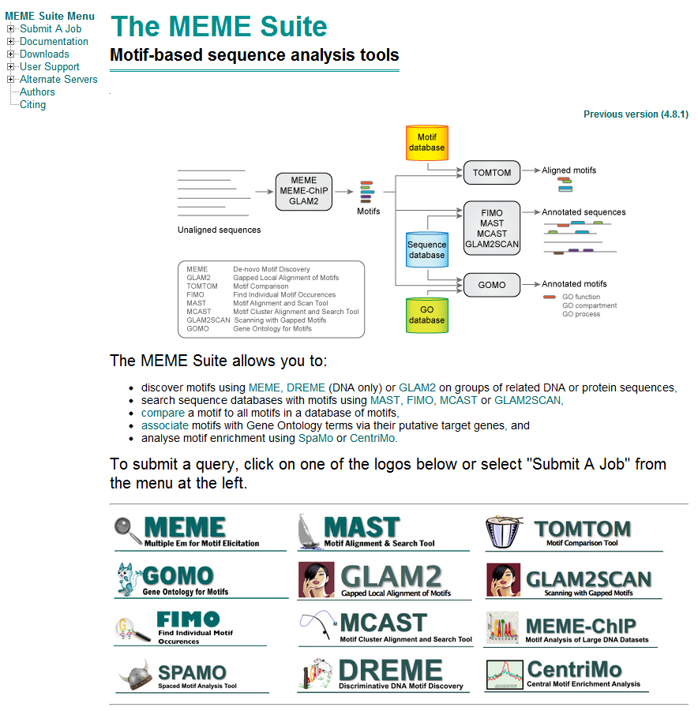
MEME
MEME - implements EM for motif discovery in DNA and proteins
MAST – search sequences for motifs given a model
References
Timothy L. Bailey, Mikael Bodén, Fabian A. Buske, Martin Frith, Charles E. Grant, Luca Clementi, Jingyuan Ren, Wilfred W. Li, William S. Noble, "MEME SUITE: tools for motif discovery and searching", Nucleic Acids Research, 37:W202-W208, 2009.
http://meme.sdsc.edu/meme/

Slide 48
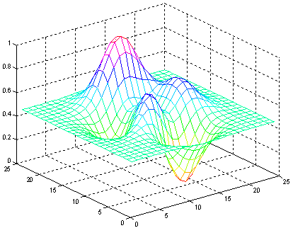
P(Seq|Model) Landscape
EM searches for parameters to increase P(seqs|parameters)
Useful to think of P(seqs|parameters)
as a function of parameters
EM starts at an initial set of
parameters
P(Sequences|params1,params2)
And then “climbs uphill” until it reaches a local maximum
Parameter1
Parameter2
Where EM starts can make a big difference

Slide 49
Search from Many Different Starts
To minimize the effects of local maxima, you should search
multiple times from different starting points
MEME uses this idea
Start at many points
Run for one iteration
Choose starting point that got
the “highest” and continue
P(Sequences|params1,params2)
Parameter1
Parameter2

Slide 50
Gibbs Sampler
A stochastic version of EM that differs from deterministic EM in two key ways
At each iteration, we only update the motif position of a single sequence
We may update a motif position to a “suboptimal” new position

Slide 51
Algorithm: Gibbs Sampler
Start with random motif locations and calculate a motif model
Randomly select a sequence, remove its motif and recalculate tempory model
With temporary model, calculate probability of motif at each position on sequence
Select new position based on this distribution
Update model and Iterate

Slide 52
Sampling New Motif Positions
For each possible starting position, , compute a weight (likelihood ratio)
Randomly select a new starting position according to these weights

Slide 53
Demo: Initialization
Random choose motif location

Slide 54
Demo: Step 2
Random Select One Sequence and Remove Its Motif. Recalculate its Temporal Model
A
C
G
T
0.1
0.2
0.1
0.4
0.1
0.3
0.2
0.2
0.2
0.2
0.5
0.4
0.4
0.5
0.4
0.2
0.2
0.2
0.3
0.1
0.2
0.2
0.2
0.1

Slide 55
Demo: Step 3
Calculate Probability of motif at each position on sequence

Slide 56
Demo: Step 4
Demo: Select New Position, Update Motif Model
Best Position
New Position
A
C
G
T
0.1
0.1
0.1
0.1
0.1
0.3
0.2
0.3
0.2
0.2
0.5
0.1
0.4
0.5
0.4
0.5
0.2
0.1
0.3
0.1
0.2
0.2
0.2
0.1

Slide 57
Gibbs Sampling and Climbing
Because gibbs sampling does always choose the best new location
it can move to another place not directly uphill
P(Sequences|params1,params2)
Parameter1
Parameter2
In theory, Gibbs Sampling less likely to get stuck a local maxima

Slide 58
AlignACE
Implements Gibbs sampling for motif discovery
ScanAce – look for motifs in a sequence given a model
CompareAce – calculate “similarity” between two motifs (i.e. for clustering motifs)
Reference
Roth, F.R., Hughes, J.D., Estep, P. E. & G.M. Church. Finding DNA Regulatory Motifs within Unaligned Non-Coding Sequences Clustered by Whole-Genome mRNA Quantitation. Nature Biotechnology 16, 939 - 945 (1998)
Hughes, JD, Estep, PW, Tavazoie S & GM Church. Computational identification of cis-regulatory elements associated with groups of functionally related genes in Saccharomyces cerevisiae, Journal of Molecular Biology 2000 Mar 10;296(5):1205-14.
http://arep.med.harvard.edu/mrnadata/mrnasoft.html

Slide 59
References
Lawrence CE, Altschul SF, Boguski MS, Liu JS, Neuwald AF, Wootton JC. Detecting Subtle Sequence Signals: a Gibbs Sampling Strategy for Multiple Alignment. Science 1993 Oct 8;262(5131):208-14.

